Slide 1

CSE 470/598 Transforms 1
Ross Maciejewski
rmacieje@asu.edu

Slide 2
Disclaimer
These slides can only be used as study material for the class 470 at ASU
The slides cannot be distributed or used for another purpose

Slide 3
Concepts in Linear Algebra
3D Coordinate System
Vectors and Points in 3D space
Dot and Cross products
Matrix notation and manipulation with other matrices, 3D vectors, and 3D points
Homogeneous coordinates (x, y, z, w)
Associativity prosperity of matrix multiplication (But NOT communicative property!!)
Associative => (5 + 2) + 1 = 5 + (2 + 1)
Commutative => 5 +2 + 1 = 1 + 2 + 5
Matrix transpose and inverse

Slide 4
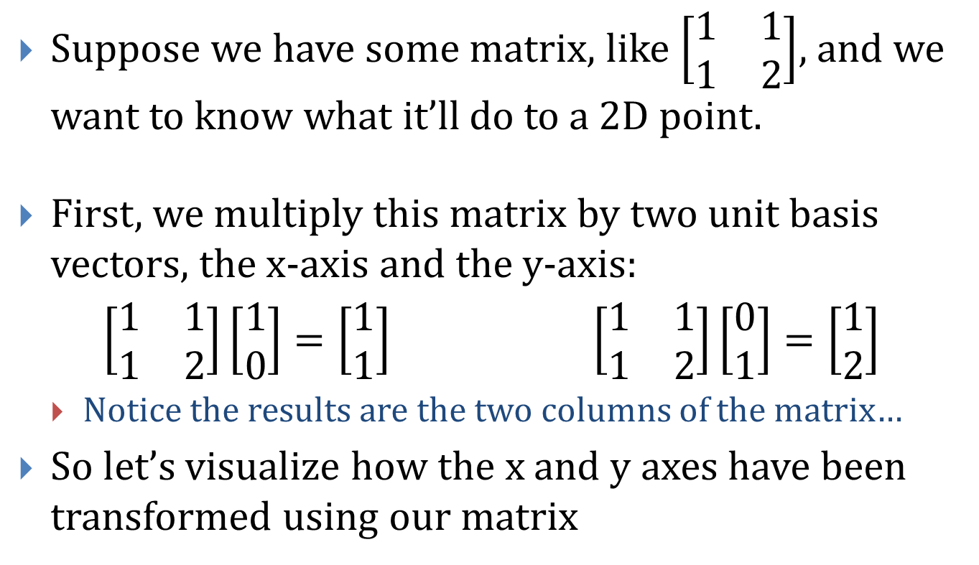
Matrix Multiplication Explained (Visually)
Suppose we have some matrix, like $\left[\begin{matrix}1 & 1 \\ 1 & 2\end{matrix}\right]$, and we want to know what it’ll do to a 2D point.
First, we multiply this matrix by two unit basis vectors, the x-axis and the y-axis:
$\left[\begin{matrix}1 & 1 \\ 1 & 2\end{matrix}\right]\left[\begin{matrix}1 \\ 0\end{matrix}\right]=\left[\begin{matrix}1 \\ 1\end{matrix}\right]$ $\left[\begin{matrix}1 & 1 \\ 1 & 2\end{matrix}\right]\left[\begin{matrix}0 \\ 1\end{matrix}\right]=\left[\begin{matrix}1 \\ 2\end{matrix}\right]$
Notice the results are the two columns of the matrix…
So let’s visualize how the x and y axes have been transformed using our matrix

Slide 5
Matrix Multiplication Explained (Visually)
Original Coordinate System
After we apply the transform

Slide 6

Matrix Multiplication Explained (Visually)
Let’s test the new coordinate system on a new point $\left[\begin{matrix}2 \\ 3\end{matrix}\right]$.
This demonstrates the concept of “change of basis”. The row vectors of the new matrix define the new basis
We see what this looks like in the original Cartesian coordinate system:

Slide 7
Questions?

Slide 8
Transformations in Computer Graphics
Elemental Transformations:
Translation
Rotation
Scaling
Shearing
Of the four, three of them are affine and linear:
Rotation, Scaling, and Shearing
One is affine but non-linear
Translation

Slide 9
Definitions of Transformations
Projective ⊃ Affine ⊃ Linear
Meaning that all linear transforms are also affine transforms, which are also projective transforms.
However, not all affine transforms are linear transforms, and not all projective transforms are affine.
Definitions:
Linear Transform:
Preserves all parallel lines
Acts on a line to yield either a line or a point
The vector [0, 0] is always transformed to [0, 0]
Examples: scale and rotate

Slide 10
Definitions of Transformations
Definitions:
Linear Transform:
Preserves parallel lines
Acts on a line to yield either a line or a point
The vector [0, 0] is always transformed to [0, 0]
Examples: scale and rotate
Affine Transform:
Preserves parallel lines
Acts on a line to yield either a line or a point
The vector [0, 0] is NOT always transformed to [0, 0]
Examples: translate
Projective Transform:
Does NOT preserve parallel lines
Acts on a line to yield either a line or a point
Examples: perspective camera (assignment 3)

Slide 11
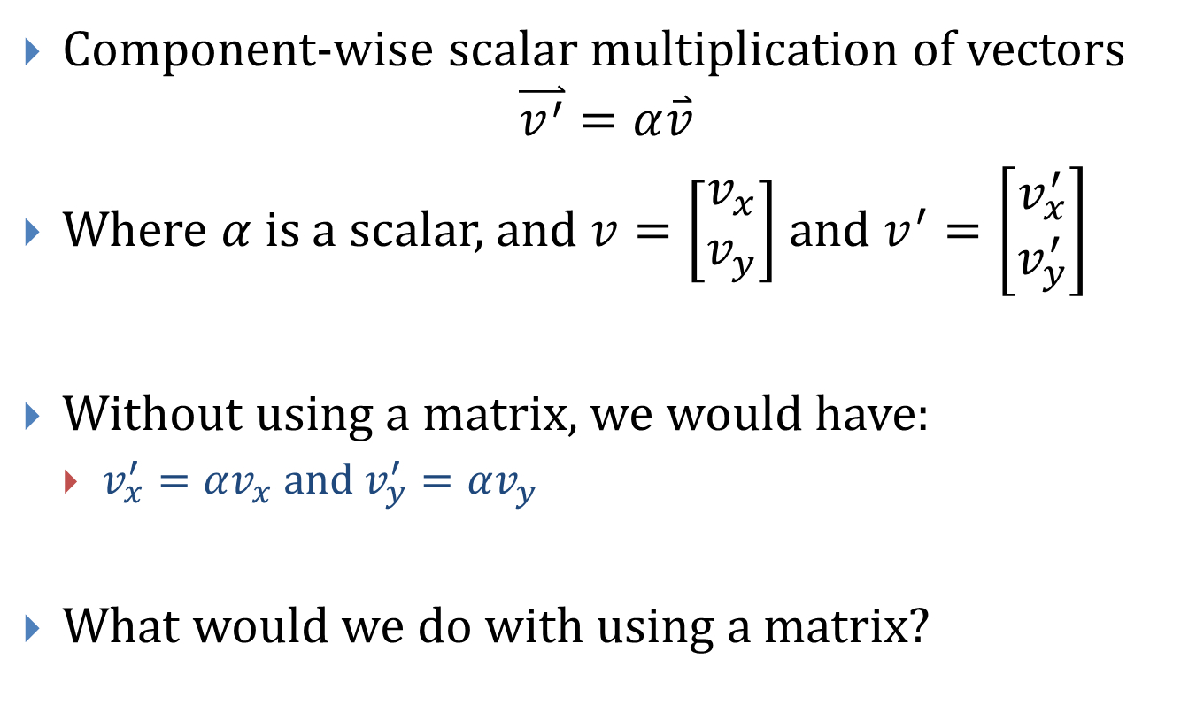
2D Scaling
Component-wise scalar multiplication of vectors
$$\overset{⃑}{v^{′}}=α\overset{⃑}{v}$$
Where $α$ is a scalar, and $v=\left[\begin{matrix}v_{x} \\ v_{y}\end{matrix}\right]$ and $v^{′}=\left[\begin{matrix}v_{x}^{′} \\ v_{y}^{′}\end{matrix}\right]$
Without using a matrix, we would have:
$v_{x}^{′}=αv_{x}$ and $v_{y}^{′}=αv_{y}$
What would we do with using a matrix?

Slide 12
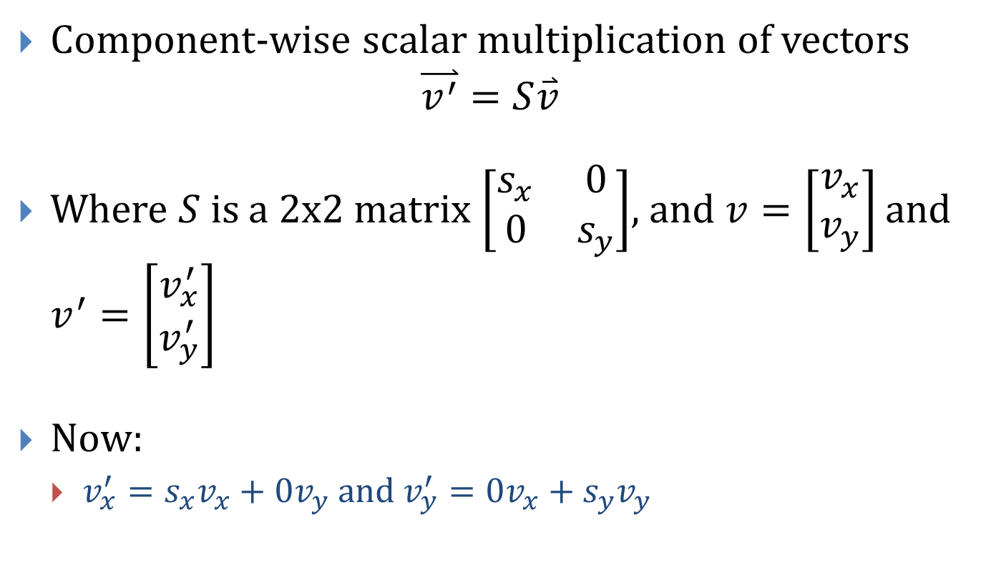
2D Scaling
Component-wise scalar multiplication of vectors
$$\overset{⃑}{v^{′}}=S\overset{⃑}{v}$$
Where $S$ is a 2x2 matrix $\left[\begin{matrix}s_{x} & 0 \\ 0 & s_{y}\end{matrix}\right]$, and $v=\left[\begin{matrix}v_{x} \\ v_{y}\end{matrix}\right]$ and $v^{′}=\left[\begin{matrix}v_{x}^{′} \\ v_{y}^{′}\end{matrix}\right]$
Now:
$v_{x}^{′}=s_{x}v_{x}+0v_{y}$ and $v_{y}^{′}=0v_{x}+s_{y}v_{y}$

Slide 13

2D Scaling, An Example
Given $S=\left[\begin{matrix}3 & 0 \\ 0 & 2\end{matrix}\right]$, what happens to the following 2 vertices of the house?
Y
6
5
4
3
2
1
0
1
2
3
4
5
6
7
8
9
10
X

Slide 14

2D Scaling, An Example
Given $S=\left[\begin{matrix}3 & 0 \\ 0 & 2\end{matrix}\right]$, what happens to the following?
Uh… Something looks wrong…
Y
6
5
4
3
2
1
0
1
2
3
4
5
6
7
8
9
10
X

Slide 15

2D Scaling, An Example
Given $S=\left[\begin{matrix}3 & 0 \\ 0 & 2\end{matrix}\right]$, what happens to the following?
What’s the problem?
Lengths of the edges are not preserved!
Angles between edges are not preserved!
Except if $S_{x}=S_{y}$
Y
6
5
4
3
2
1
0
1
2
3
4
5
6
7
8
9
10
X

Slide 16
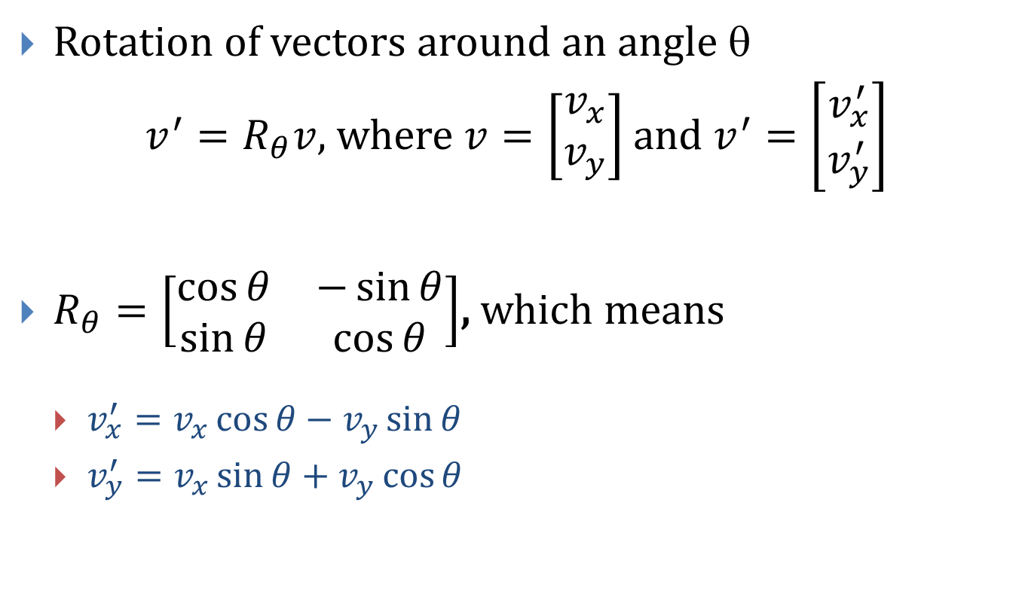
2D Rotation
Rotation of vectors around an angle θ
$v^{′}=R_{θ}v$, where $v=\left[\begin{matrix}v_{x} \\ v_{y}\end{matrix}\right]$ and $v^{′}=\left[\begin{matrix}v_{x}^{′} \\ v_{y}^{′}\end{matrix}\right]$
$R_{θ}=\left[\begin{matrix}\cos{θ} & −\sin{θ} \\ \sin{θ} & \cos{θ}\end{matrix}\right]$, which means
$v_{x}^{′}=v_{x}\cos{θ}−v_{y}\sin{θ}$
$v_{y}^{′}=v_{x}\sin{θ}+v_{y}\cos{θ}$

Slide 17
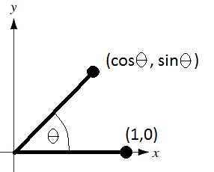
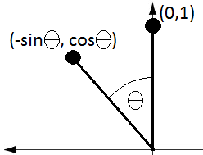
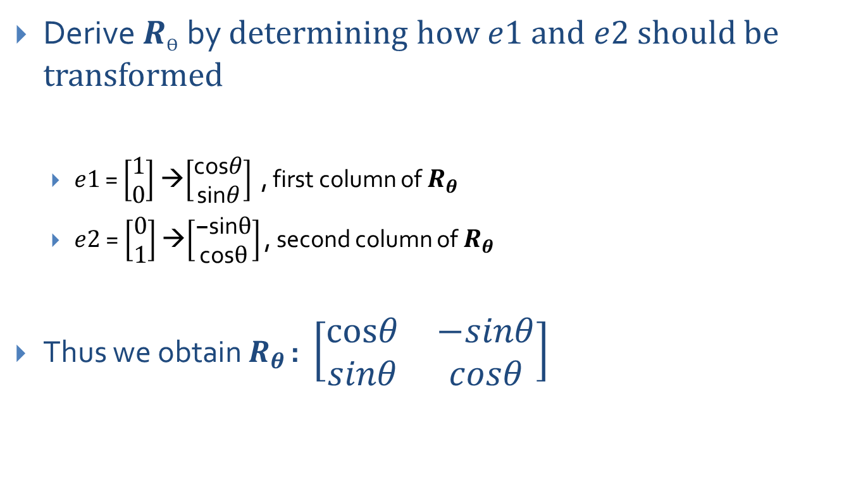
2D Rotation, Proof 1
Derive $R_{Ө}$by determining how $e1$ and $e2$ should be transformed
$e1$ = $\left[\begin{matrix}1 \\ 0\end{matrix}\right]$ →$\left[\begin{matrix}\text{cos}θ \\ \text{sin}θ\end{matrix}\right]$ , first column of $R_{θ}$
$e2$= $\left[\begin{matrix}0 \\ 1\end{matrix}\right]$ →$\left[\begin{matrix}\text{−}\text{sin}θ \\ \text{cos}θ\end{matrix}\right]$ , second column of $R_{θ}$
Thus we obtain $R_{θ}$: $\left[\begin{matrix}cosθ & −sinθ \\ sinθ & cosθ\end{matrix}\right]$

Slide 18
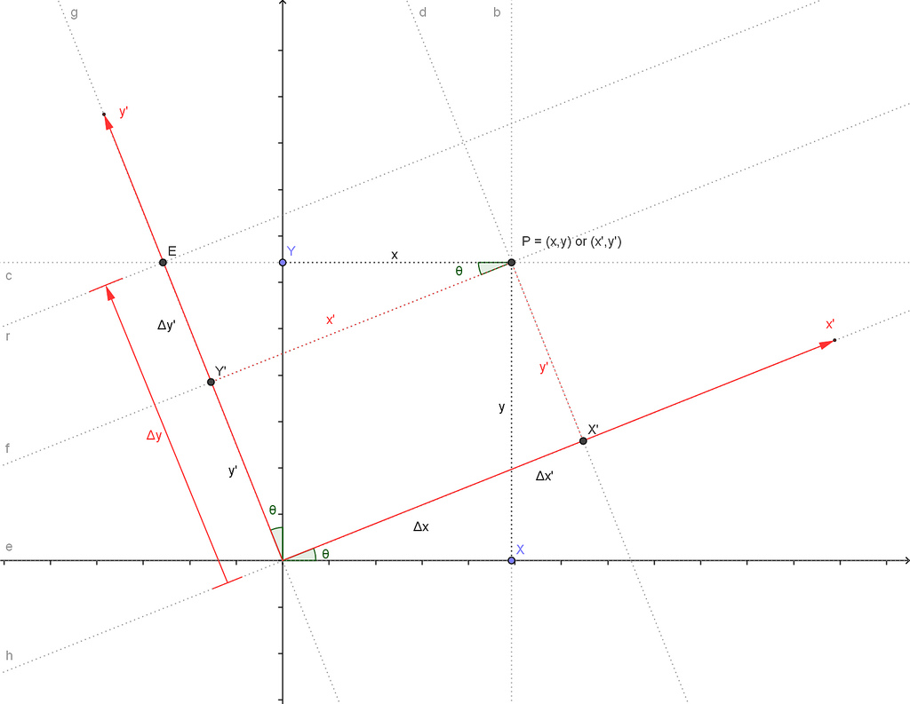
2D Rotation, Proof 2

Slide 19
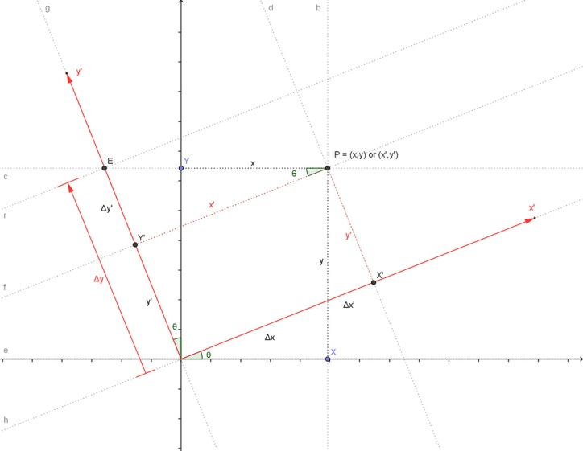
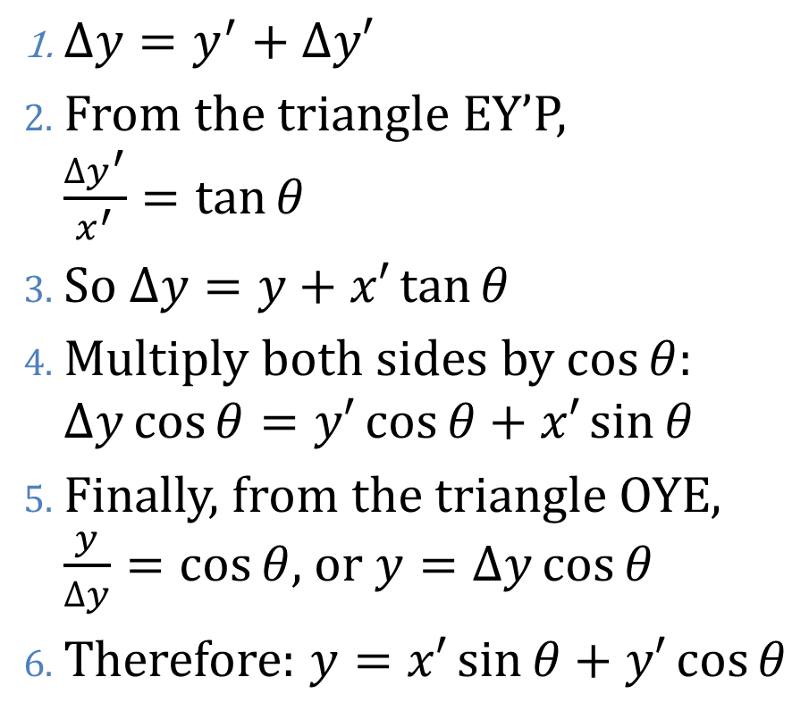
2D Rotation, Proof 2
$∆y=y^{′}+∆y′$
From the triangle EY’P, $\frac{∆y^{′}}{x^{′}}=\tan{θ}$
So $∆y=y+x′\tan{θ}$
Multiply both sides by $\cos{θ}$: $∆y\cos{θ}=y′\cos{θ}+x′\sin{θ}$
Finally, from the triangle OYE, $\frac{y}{∆y}=\cos{θ}$, or $y=∆y\cos{θ}$
Therefore: $y=x′\sin{θ}+y′\cos{θ}$

Slide 20
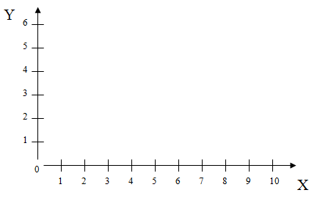
2D Rotation Example
What would the outcome be?
How would you do this in pseudo code?

Slide 21
2D Rotation Example
Result:
Y
6
5
4
3
2
1
0
1
2
3
4
5
6
7
8
9
10
X

Slide 22
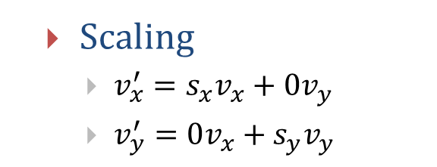
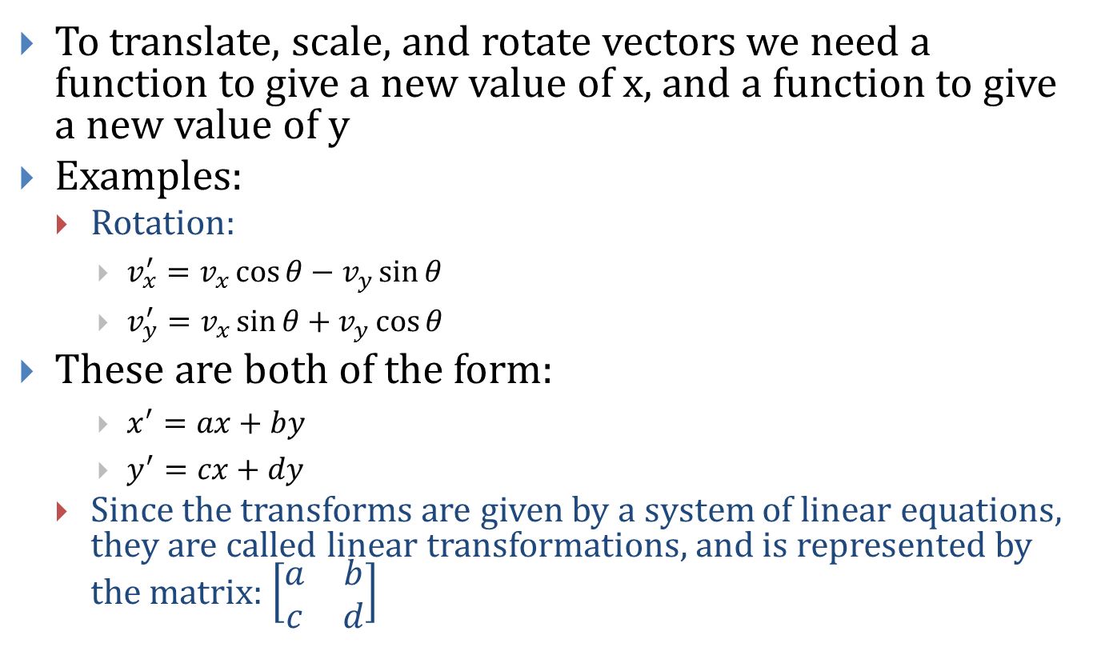
Sets of Linear Equations and Matrices
To translate, scale, and rotate vectors we need a function to give a new value of x, and a function to give a new value of y
Examples:
Rotation:
$v_{x}^{′}=v_{x}\cos{θ}−v_{y}\sin{θ}$
$v_{y}^{′}=v_{x}\sin{θ}+v_{y}\cos{θ}$
These are both of the form:
$x^{′}=ax+by$
$y^{′}=cx+dy$
Since the transforms are given by a system of linear equations, they are called linear transformations, and is represented by the matrix: $\left[\begin{matrix}a & b \\ c & d\end{matrix}\right]$
Scaling
$v_{x}^{′}=s_{x}v_{x}+0v_{y}$
$v_{y}^{′}=0v_{x}+s_{y}v_{y}$

Slide 23
Questions?

Slide 24
2D Translation
Goal: moving a house from location A to location B:
Pretty easy… Just add 5 to x and 3 to y
If there are multiple vertices in the house, apply the addition to each and every vertex
R ²
Y
B = (7, 6)
Y
6
5
4
3
A = (2, 3)
2
1
0
1
2
3
4
5
6
7
8
9
10
X

Slide 25
2D Translate
In matrix notation, this means:
$v^{′}=v+t$ where $v^{′}=$ $\left[\begin{matrix}x′ \\ y′\end{matrix}\right]$, $v=\left[\begin{matrix}x \\ y\end{matrix}\right]$, and $t=\left[\begin{matrix}dx \\ dy\end{matrix}\right]$
which means: $x^{′}=x+dx$ and $y^{′}=y+dy$
Translation:
Preserves lengths (isometric)
Preserves angles (conformal)
Y
6
5
4
dx = 2
dy = 3
3
2
1
0
1
2
3
4
5
6
7
8
9
10
X

Slide 26
2D Translation
Exercise: consider linear transformations
$x^{′}=ax+by$
$y^{′}=cx+dy$
In matrix form:$\left[\begin{matrix}x′ \\ y′\end{matrix}\right]=\left[\begin{matrix}a & b \\ c & d\end{matrix}\right]\left[\begin{matrix}x \\ y\end{matrix}\right]$
Can translation be expressed as a linear transformation?
$x^{′}=x+dx$
$y^{′}=y+dy$
Think back to the previous translation example…

Slide 27
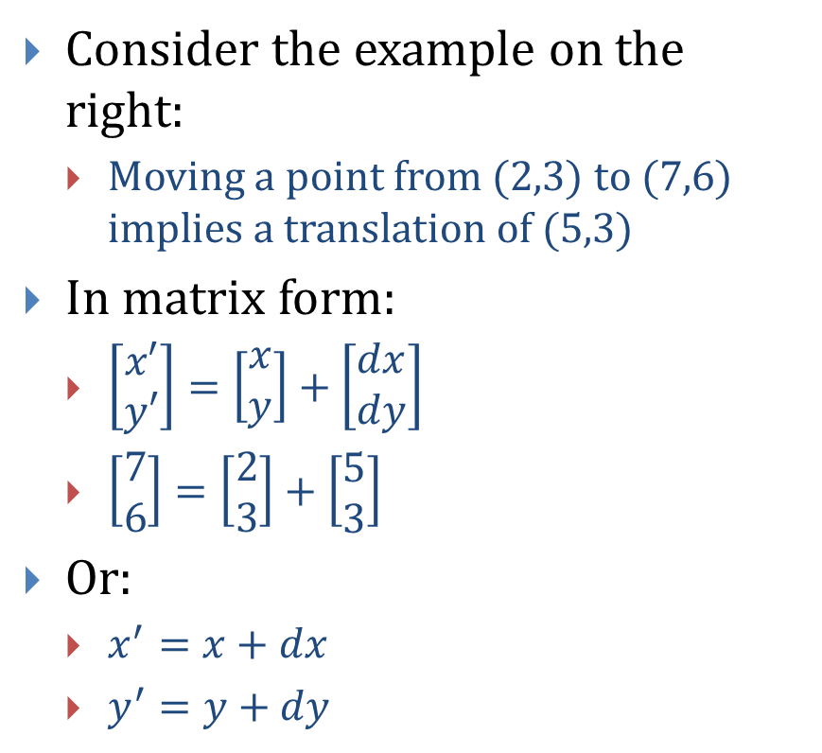
2D Translation
Consider the example on the right:
Moving a point from (2,3) to (7,6) implies a translation of (5,3)
In matrix form:
$\left[\begin{matrix}x′ \\ y′\end{matrix}\right]=\left[\begin{matrix}x \\ y\end{matrix}\right]+\left[\begin{matrix}dx \\ dy\end{matrix}\right]$
$\left[\begin{matrix}7 \\ 6\end{matrix}\right]=\left[\begin{matrix}2 \\ 3\end{matrix}\right]+\left[\begin{matrix}5 \\ 3\end{matrix}\right]$
Or:
$x^{′}=x+dx$
$y^{′}=y+dy$
R ²
there = (7, 6)
Y
Y
6
5
4
3
here = (2, 3)
2
1
0
1
2
3
4
5
6
7
8
9
10
X

Slide 28
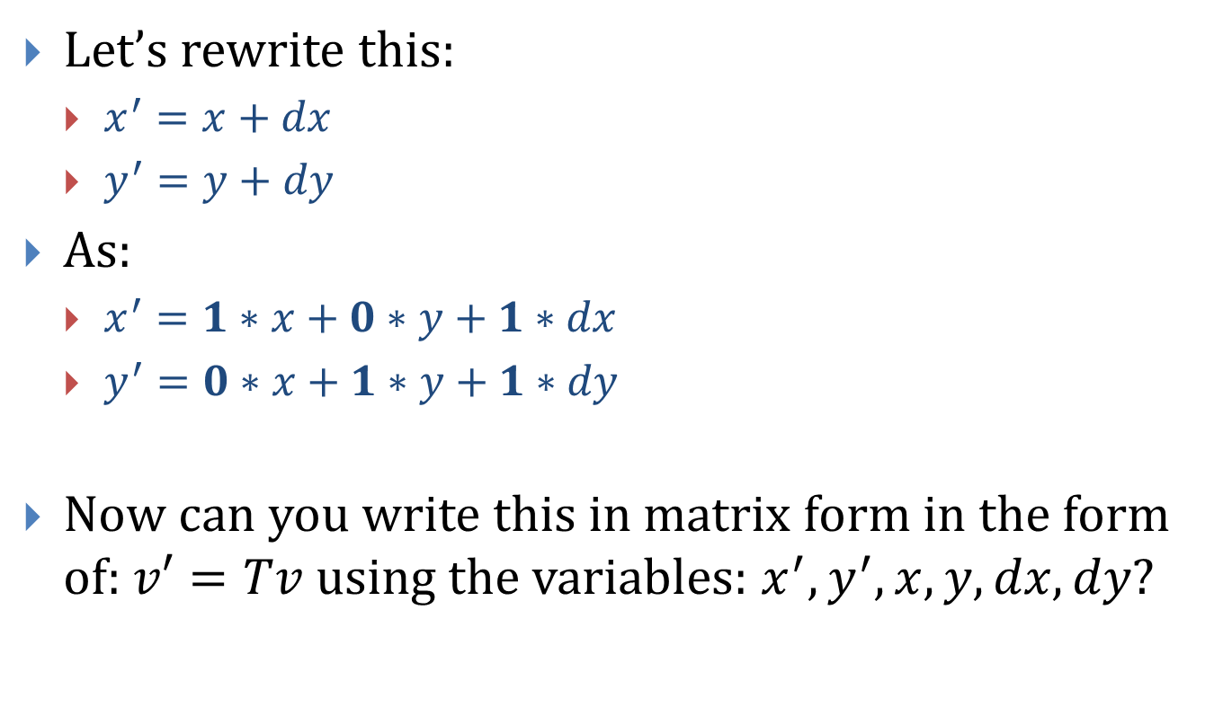
2D Translation
Let’s rewrite this:
$x^{′}=x+dx$
$y^{′}=y+dy$
As:
$x^{′}=1∗x+0∗y+1∗dx$
$y^{′}=0∗x+1∗y+1∗dy$
Now can you write this in matrix form in the form of: $v′=Tv$ using the variables: $x^{′}, y^{′}, x, y, dx, dy$?

Slide 29
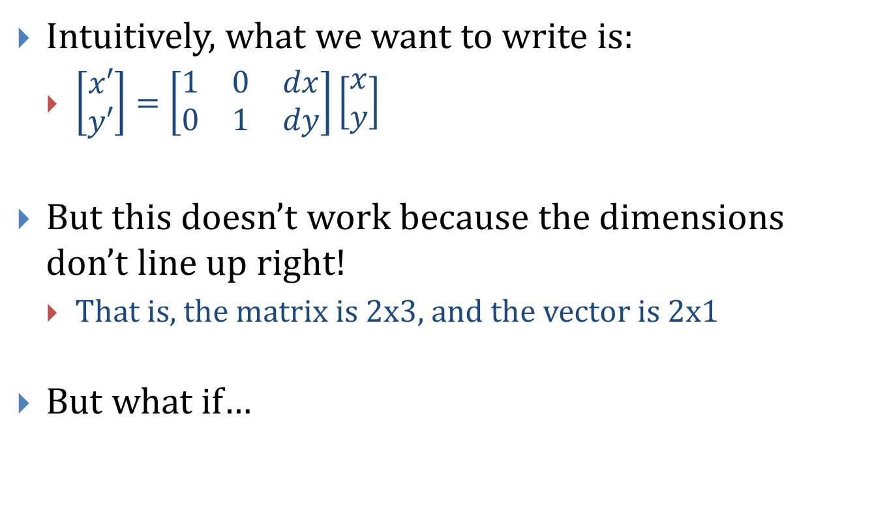
2D Translation
Intuitively, what we want to write is:
$\left[\begin{matrix}x′ \\ y′\end{matrix}\right]=\left[\begin{matrix}1 & 0 & dx \\ 0 & 1 & dy\end{matrix}\right]\left[\begin{matrix}x \\ y\end{matrix}\right]$
But this doesn’t work because the dimensions don’t line up right!
That is, the matrix is 2x3, and the vector is 2x1
But what if…

Slide 30
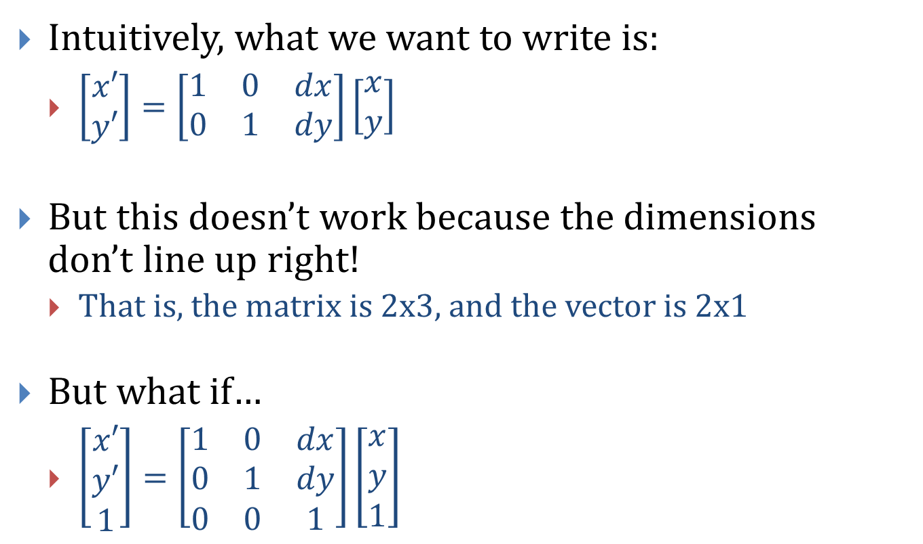
2D Translation
Intuitively, what we want to write is:
$\left[\begin{matrix}x′ \\ y′\end{matrix}\right]=\left[\begin{matrix}1 & 0 & dx \\ 0 & 1 & dy\end{matrix}\right]\left[\begin{matrix}x \\ y\end{matrix}\right]$
But this doesn’t work because the dimensions don’t line up right!
That is, the matrix is 2x3, and the vector is 2x1
But what if…
$\left[\begin{matrix}x′ \\ y′ \\ 1\end{matrix}\right]=\left[\begin{matrix}1 & 0 & dx \\ 0 & 1 & dy \\ 0 & 0 & 1\end{matrix}\right]\left[\begin{matrix}x \\ y \\ 1\end{matrix}\right]$

Slide 31
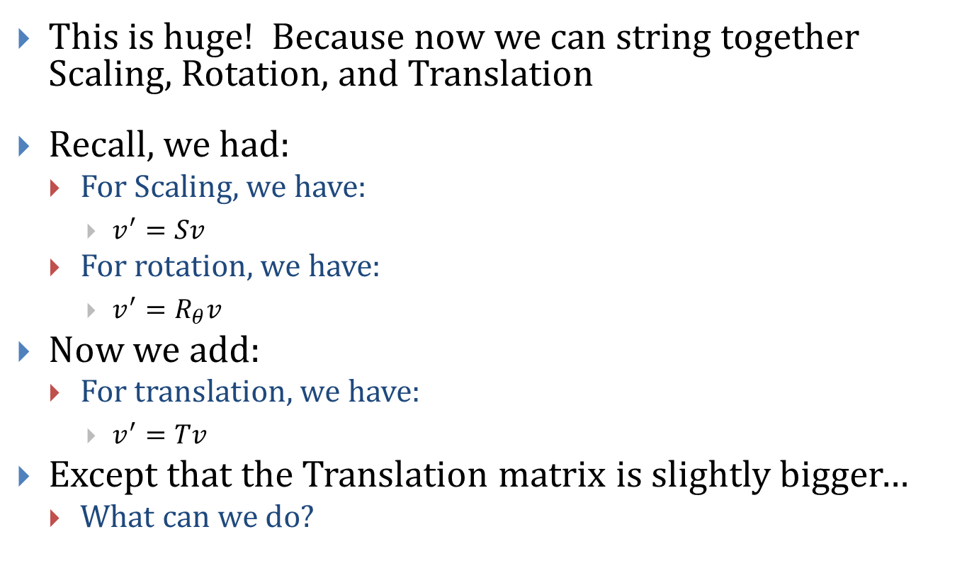
Composite Matrix Transform
This is huge! Because now we can string together Scaling, Rotation, and Translation
Recall, we had:
For Scaling, we have:
$v^{′}=Sv$
For rotation, we have:
$v^{′}=R_{θ}v$
Now we add:
For translation, we have:
$v^{′}=Tv$
Except that the Translation matrix is slightly bigger…
What can we do?

Slide 32
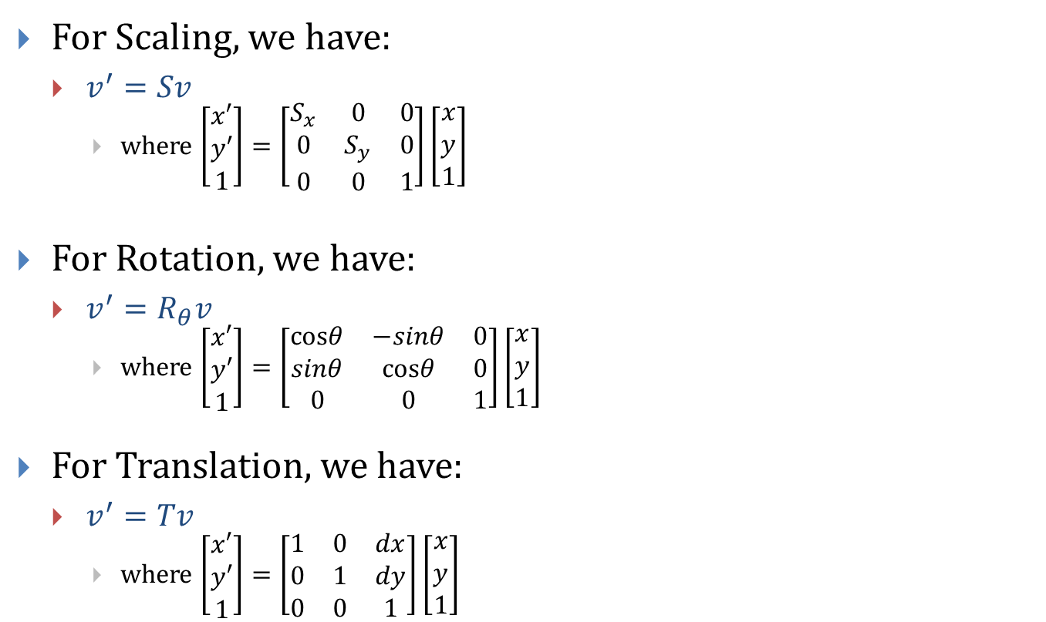
Recap
For Scaling, we have:
$v^{′}=Sv$
where $\left[\begin{matrix}x′ \\ y′ \\ 1\end{matrix}\right]=\left[\begin{matrix}S_{x} & 0 & 0 \\ 0 & S_{y} & 0 \\ 0 & 0 & 1\end{matrix}\right]\left[\begin{matrix}x \\ y \\ 1\end{matrix}\right]$
For Rotation, we have:
$v^{′}=R_{θ}v$
where $\left[\begin{matrix}x′ \\ y′ \\ 1\end{matrix}\right]=\left[\begin{matrix}cosθ & −sinθ & 0 \\ sinθ & cosθ & 0 \\ 0 & 0 & 1\end{matrix}\right]\left[\begin{matrix}x \\ y \\ 1\end{matrix}\right]$
For Translation, we have:
$v^{′}=Tv$
where $\left[\begin{matrix}x′ \\ y′ \\ 1\end{matrix}\right]=\left[\begin{matrix}1 & 0 & dx \\ 0 & 1 & dy \\ 0 & 0 & 1\end{matrix}\right]\left[\begin{matrix}x \\ y \\ 1\end{matrix}\right]$

Slide 33
Uh, What Was That Again?
What just happened to creating the Translation matrix?
What does it mean to add the extra 1?
This is called Homogeneous Coordinates: add an additional dimension, the w-axis, and an extra coordinate, the w-component
Thus 2D->3D (effectively the hyperspace for embedding 2D space)

Slide 34
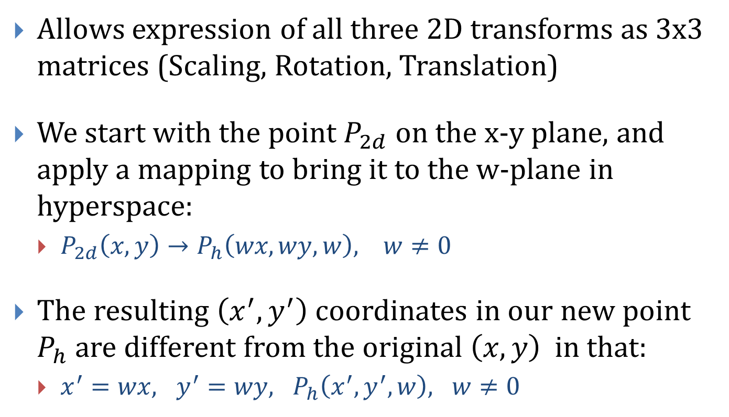
Homogeneous Coordinates
Allows expression of all three 2D transforms as 3x3 matrices (Scaling, Rotation, Translation)
We start with the point $P_{2d}$ on the x-y plane, and apply a mapping to bring it to the w-plane in hyperspace:
$P_{2d}\left(x, y\right)→P_{h}\left(wx, wy, w\right), w≠0$
The resulting $\left(x^{′}, y^{′}\right)$ coordinates in our new point $P_{h}$ are different from the original $\left(x, y\right)$ in that:
$x^{′}=wx, y^{′}=wy, P_{h}\left(x^{′}, y^{′}, w\right), w≠0$

Slide 35
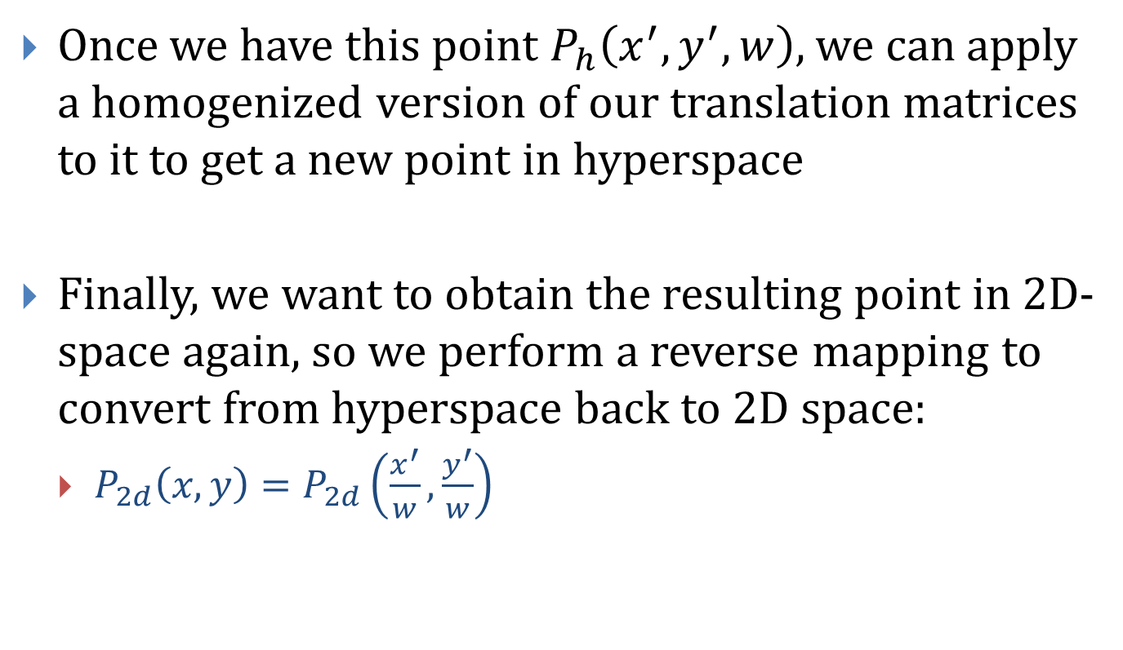
Homogeneous Coordinates
Once we have this point $P_{h}\left(x^{′}, y^{′}, w\right)$, we can apply a homogenized version of our translation matrices to it to get a new point in hyperspace
Finally, we want to obtain the resulting point in 2D-space again, so we perform a reverse mapping to convert from hyperspace back to 2D space:
$P_{2d}\left(x,y\right)=P_{2d}\left(\frac{x^{′}}{w},\frac{y^{′}}{w}\right)$

Slide 36
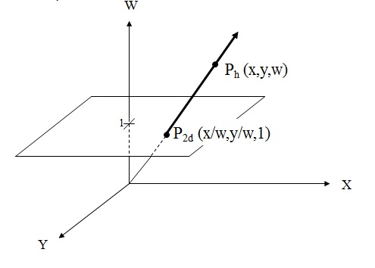
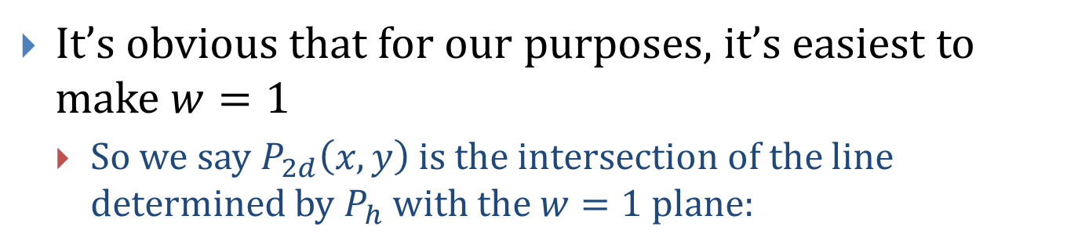
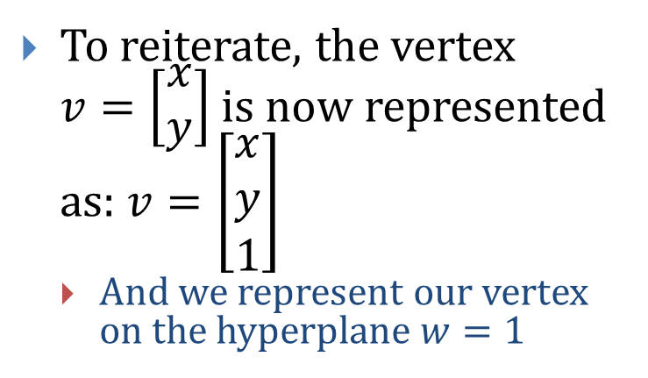
Homogeneous Coordinates
It’s obvious that for our purposes, it’s easiest to make $w=1$
So we say $P_{2d}\left(x,y\right)$ is the intersection of the line determined by $P_{h}$ with the $w=1$ plane:
To reiterate, the vertex $v=\left[\begin{matrix}x \\ y\end{matrix}\right]$ is now represented as: $v=\left[\begin{matrix}x \\ y \\ 1\end{matrix}\right]$
And we represent our vertex on the hyperplane $w=1$

Slide 37
Questions?

Slide 38
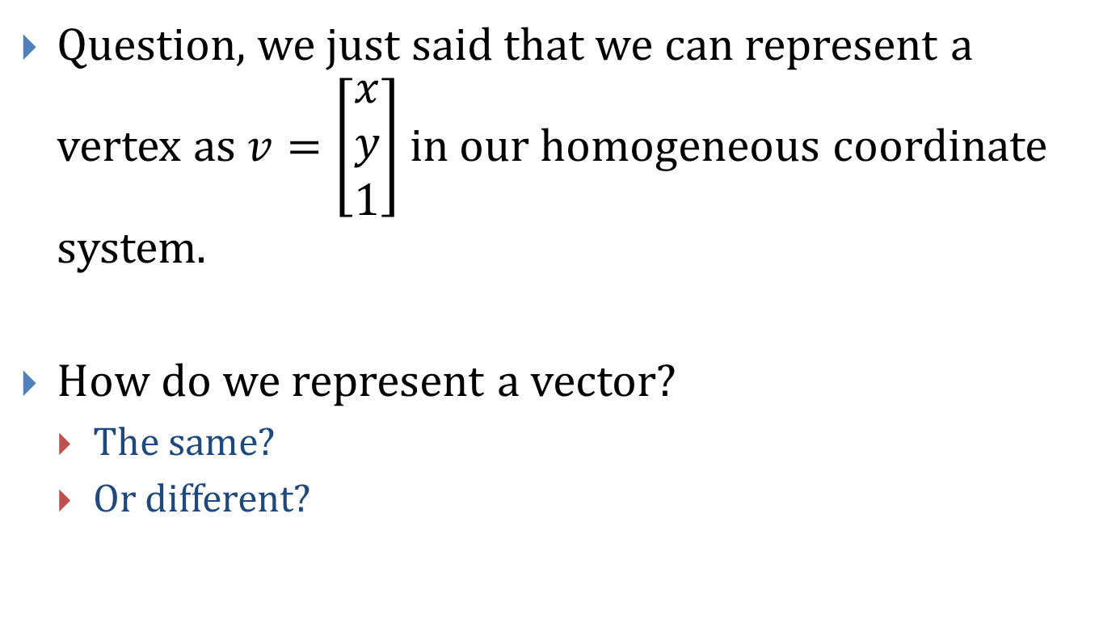
Points vs. Vectors
Question, we just said that we can represent a vertex as $v=\left[\begin{matrix}x \\ y \\ 1\end{matrix}\right]$ in our homogeneous coordinate system.
How do we represent a vector?
The same?
Or different?

Slide 39
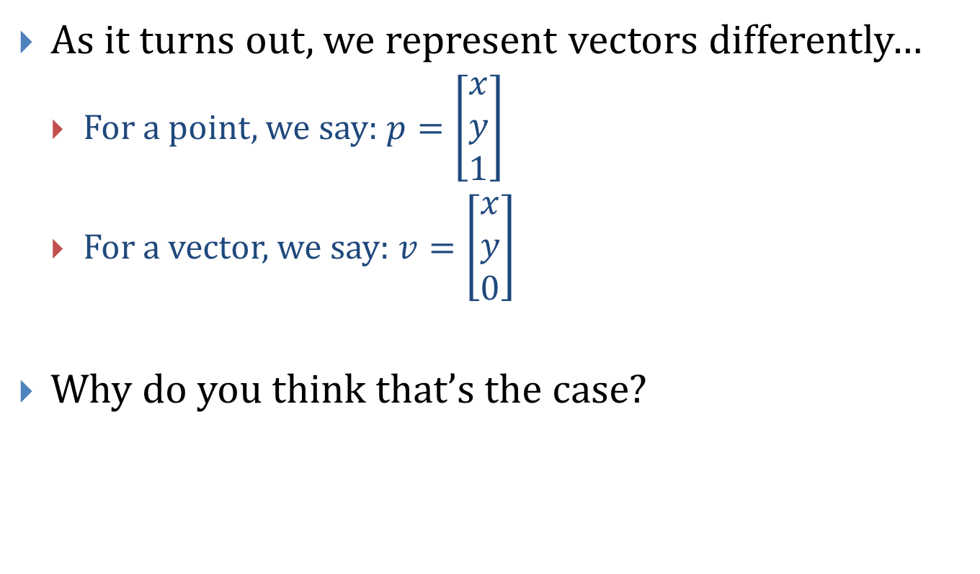
Points vs. Vectors
As it turns out, we represent vectors differently…
For a point, we say: $p=\left[\begin{matrix}x \\ y \\ 1\end{matrix}\right]$
For a vector, we say: $v=\left[\begin{matrix}x \\ y \\ 0\end{matrix}\right]$
Why do you think that’s the case?

Slide 40

Find the values of x’, y’ and w’
For Scaling, we have:
$v^{′}=Sv$
where $\left[\begin{matrix}x′ \\ y′ \\ w′\end{matrix}\right]=\left[\begin{matrix}S_{x} & 0 & 0 \\ 0 & S_{y} & 0 \\ 0 & 0 & 1\end{matrix}\right]\left[\begin{matrix}x \\ y \\ 0\end{matrix}\right]$
For Rotation, we have:
$v^{′}=R_{θ}v$
where $\left[\begin{matrix}x′ \\ y′ \\ w′\end{matrix}\right]=\left[\begin{matrix}cosθ & −sinθ & 0 \\ sinθ & cosθ & 0 \\ 0 & 0 & 1\end{matrix}\right]\left[\begin{matrix}x \\ y \\ 0\end{matrix}\right]$
For Translation, we have:
$v^{′}=Tv$
where $\left[\begin{matrix}x′ \\ y′ \\ w′\end{matrix}\right]=\left[\begin{matrix}1 & 0 & dx \\ 0 & 1 & dy \\ 0 & 0 & 1\end{matrix}\right]\left[\begin{matrix}x \\ y \\ 0\end{matrix}\right]$

Slide 41
Cool!
What did we just find out?
That a vector can be
Scaled
Rotated
But NOT
Translated…
Which fits our original definition of a vector!

Slide 42
Questions?

Slide 43
Our Local Coordinate System
int main(int argc, char** argv)
{
…………..
glutInitWindowSize(500, 500);
glutInitWindowPosition(200, 200);
glutCreateWindow("Coordinates");
……………
/* create a callback routine for (re-)display */
glutDisplayFunc(display);
}

Slide 44
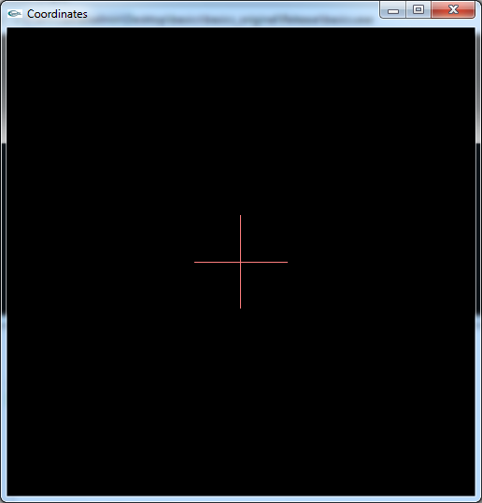
Our Local Coordinate System
void display()
{
/* clear the screen*/
glClear(GL_COLOR_BUFFER_BIT);
glMatrixMode(GL_MODELVIEW);
glLoadIdentity();
glColor3f(1, .5, .5);
drawAxes();
}
Void drawAxes(){
glBegin(GL_LINES);
glVertex2f(0, -.2);
glVertex2f(0, .2);
glEnd();
glBegin(GL_LINES);
glVertex2f(-.2, 0);
glVertex2f(.2, 0);
glEnd();
}

Slide 45
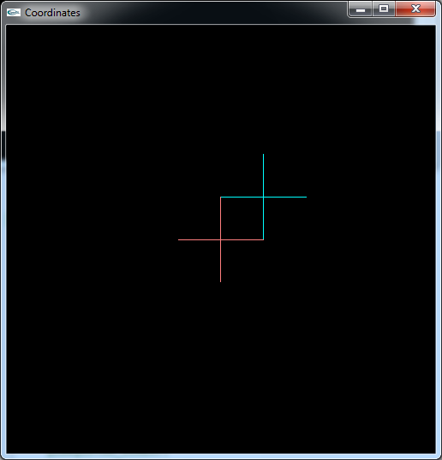
Our Local Coordinate System
Now I want to move my local coordinate system to (.2, .2)
What do I do?
glTranslatef(.2, .2, 0);
glColor3f(0, 1, 1);
drawAxes();

Slide 46
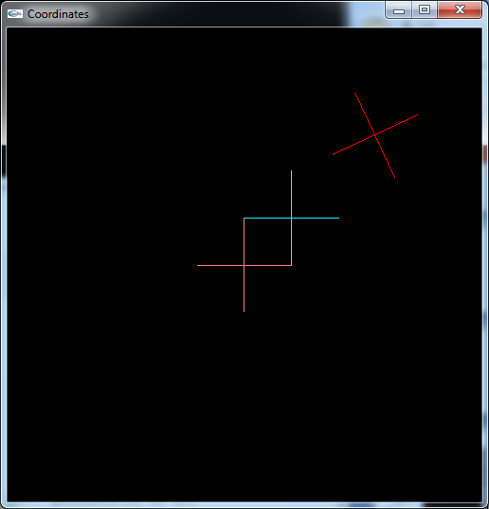
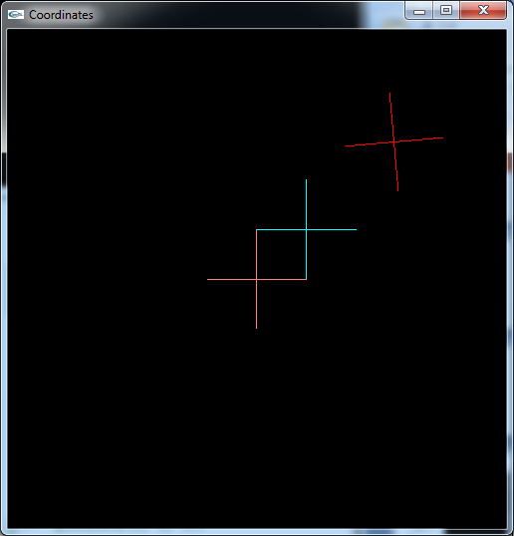


Our Local Coordinate System
Now I want to rotate an object about the center of my new local coordinate system.
What do I do?
glTranslatef(.35, .35, 0);
glRotatef(angle, 0, 0, 1);
drawAxes()

Slide 47
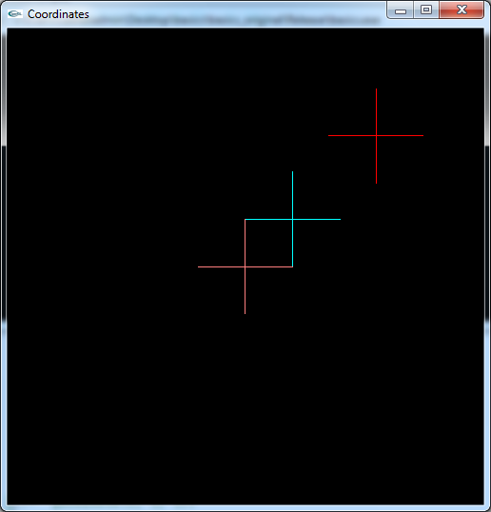
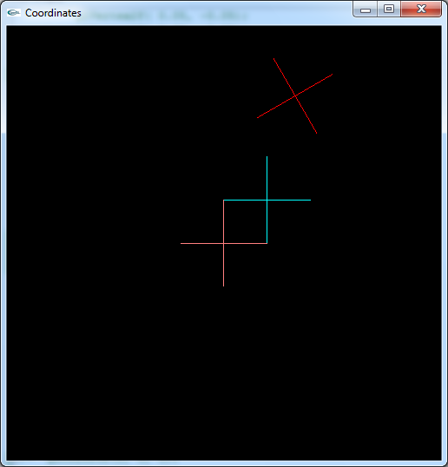
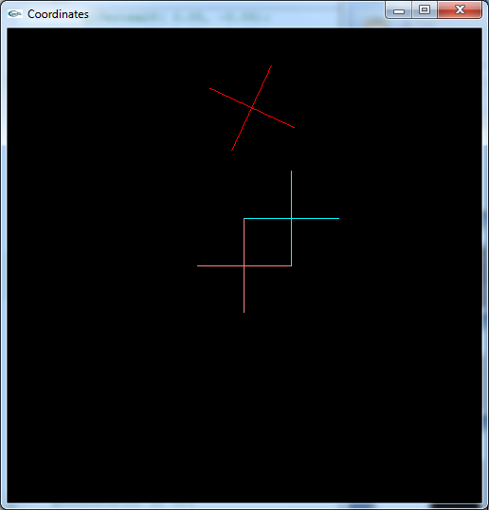
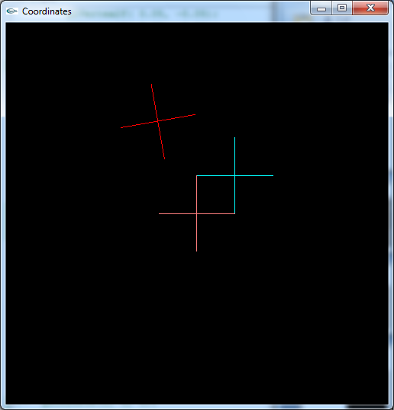
Our Local Coordinate System
Now I want to rotate an object about the center of my new local coordinate system.
What do I do?
glRotatef(angle, 0, 0, 1);
glTranslatef(.35, .35, 0);
glRotatef(-angle, 0, 0, 1);
drawAxes()
Your new local coordinate system is rotated if you don’t add this in!

Slide 48
Our Local Coordinate System
I want to rotate yet another object around my new new local coordinate system.
How do I do that?
glRotatef(angle/2, 0, 0, 1);
glTranslatef(.1, .1, 0);
Program Example

Slide 49
Our Local Coordinate System
What if I had wanted to rotate two separate things about our send local coordinate system, do I have to do all my matrix operations again?
NO!
-Translate to first local coordinate system.
- Translate to second local coordinate system.
Now, I want to draw two objects rotating about this
- glPushMatrix(); /*This saves the matrix that gives me our current local coordinate system (LCS != Local Comic Store)
- Draw your first object with rotation, translate, etc.
- glPopMatrix; /*This undoes the matrix operations done in drawing our first object */
- Draw your second object with its rotation, translate, etc.

Slide 50
Other Concepts

Slide 51
Viewports
Defines a rectangular region in window for drawing Example: Powerpoint slide edit viewport, slide layout viewport, slides overview viewport. Example: Car control viewport and car viewport
window
viewports

Slide 52
Viewports
glViewport(x, y, width, height)
Parameters in terms of pixels
Keep in mind that the windowing system returns [x,y] relative to the origin at the upper-left corner, but the viewport is defined relative to the origin at the lower-left corner.
height
x
y
width
-- when ready to draw, set the appropriate viewport
-- aspect ratio of viewport = aspect ratio of ortho2D
-- when window resized, must resize viewport

Slide 53
Viewports
glMatrixMode(GL_PROJECTION);
glLoadIdentity();
gluOrtho2D(-1.0, 1.0, -.8, .8);
glViewport(0, 0, window_width, .2*window_height);
glViewport(0, .2*window_height, window_width, .8*window_height);
glMatrixMode(GL_MODELVIEW);
glLoadIdentity();
DRAW SOMETHING …
glMatrixMode(GL_PROJECTION);
glLoadIdentity();
/* the window will correspond to these world coorinates */
gluOrtho2D(-1.0, 1.0, -.2, .2);
glViewport(0, 0, window_width, .2*window_height);
glMatrixMode(GL_MODELVIEW);
glLoadIdentity();
DRAW SOMETHING ELSE
Window Width and Height come from my reshape function

Slide 54
Coordinate Systems
Object → World → Viewport → Window
Input geometry: e.g. star vertices created at origin
space or spacecraft scene
portion of window you’ll draw to
input geometry should be transformed (translate, rotate, scale) to live in your world
window to viewport to world transformation needed

Slide 55
Bitmapped Fonts
set position glRasterPos2f(x, y); (in world coordinates)
create character glutBitmapCharacter(GLUT_BITMAP_TIMES_ROMAN_10, ‘H’);
you can find more fonts in glut.h
Next: Display lists are a good way to use fonts.
For 2D bitmapped fonts ok. For 3D stroke fonts might be better – can scale and rotate

Slide 56
Display Lists
Rendering modes: immediate and retained
immediate:
-- what we have been doing
-- primitives down pipeline then no longer in system (on screen)
-- primitives generated with each redraw
-- can be slow for complex scene or in client/server environment
retained:
-- primitives and states stored as an object in a display list
-- internal format makes them fast for display; cached
-- good for redrawing geometry multiple times
-- good for fast redraw of a complex object/scene

Slide 57
Display Lists
Define a single display list: #define SQUARE glNewList(SQUARE, GL_COMPILE); glPushAttrib(GL_CURRENT_BIT); glColor3f(1, 0, 0); glRectf(0, 0, 1, 1); glPopAttrib(); glEndList();
Draw this display list glCallList(SQUARE);
see next topic: Attributes
forming of display list called compiling it
RedBook: See Ch 7

Slide 58
Multiple Display Lists
When working with many display lists for example: text
the multiple list utilities are nice
find the starting point for 256 consecutive, free integers for DL
font_base = glGenLists(256);
for(i=0; i < 256; i++) {
glNewList(base + i, GL_COMPILE);
glutBitMapCharacter(GLUT_BITMAP…., i);
glEndList();
}
…
char *text;
glListBase(font_base);
glCallLists( (GLint) strlen(text), GL_UNSIGNED_BYTE, text);
start accessing DL from base

Slide 59
Attribute Groups
State variables are grouped see chapter 2 “Attribute Groups” for a list Example: all line characteristics (width, stipple, pattern, …) in GL_LINE_BIT
Example from display list slide:
glPushAttrib(GL_CURRENT_BIT); glColor3f(1, 0, 0); glRectf(0, 0, 1, 1);
glPopAttrib();
> save current state > change the color and draw > restore the state as it was

Slide 60
Bounding Boxes
V₁
V₅
V₂
V₄
V₃
The bounding box of a polygon is a rectangle, with the lower left point being (min_{x}(V), min_{y}(V)) and the upper right point being (max_{x}(V), max_{y}(V))
Now, how do I detect a collision?
See if any of the four corners of the dinosaur are in the house box!

Slide 61
Collisions
V₁
V₁
V₂
V₅
V₂
V₅
V₃
V₄
V₃
V₄
V₁
V₅
V₂
V₄
V₃

